Slide 1

Monitoring Application Metrics Using AWS CloudWatch
Vaibhav L Jawalkar 2210030065
Under the esteemed guidance of
Ms. P. Sree Lakshmi
Assistant Professor,
Department of Computer Science and Engineering

Slide 2
Project Overview
Deploy an EC2 instance and enable monitoring.
Use AWS CloudWatch to track CPU utilization.
Set up alarms based on predefined thresholds.
Configure Amazon SNS to send notifications when alarms are triggered.
Understand the importance of cloud monitoring in maintaining application reliability.

Slide 3
Services Used
Amazon EC2 (Elastic Compute Cloud) :Amazon EC2 is a web service that provides resizable compute capacity in the cloud. It allows users to run virtual servers and manage applications efficiently.
Amazon CloudWatch: Amazon CloudWatch is a monitoring and observability service that provides data and insights to track application performance.
Amazon SNS (Simple Notification Service):Amazon SNS is a fully managed messaging service that enables sending notifications to subscribers.

Slide 4
Flow Diagram
Diagrammatic representation of the architecture.
Clearly show interaction between AWS services.
Mention tools used: CLI, Console, SDKs (if applicable)

Slide 5
Implementation Process
Step 1: Log into AWS Free Tier Account
• Access the AWS Management Console using credentials.
• Ensure AWS Free Tier eligibility for cost-effective usage.
Step 2: Create an EC2 Instance
• Navigate to the EC2 dashboard and select "Launch Instance."
• Choose an appropriate AMI (Amazon Machine Image), such as
Amazon Linux 2.

Slide 6
Step 3: Check Instance Status
Verify that the instance is running without issues.
Ensure instance health checks are passed.
Step 4: Access CloudWatch
Navigate to the CloudWatch service from the AWS Management Console.
Select EC2 metrics and monitor CPU utilization in real-time.
Step 5: Connect to the EC2 Instance
Use SSH to establish a secure connection.
Execute commands to monitor CPU usage.

Slide 7
Key Features and Functionality
• Understand the importance of monitoring application performance in
the cloud.
• Gain hands-on experience with AWS services such as EC2,
CloudWatch, and SNS.
• Learn how to set up alarms and notifications to proactively manage
application performance.
• Develop skills in using the AWS Management Console for resource
management.
• Enhance their ability to respond to real-time performance issues in
cloud environments.

Slide 8
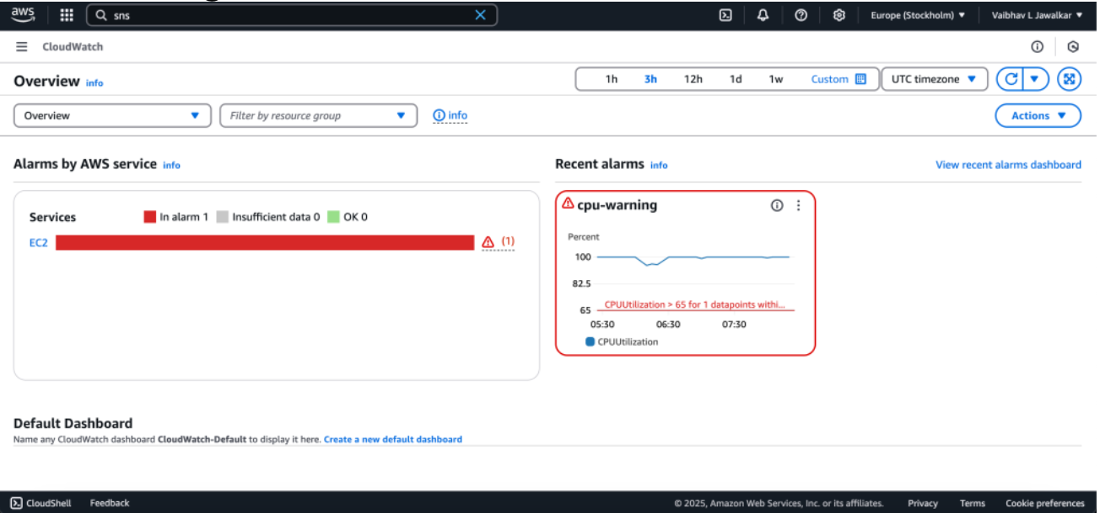
Results and Outputs

Slide 9
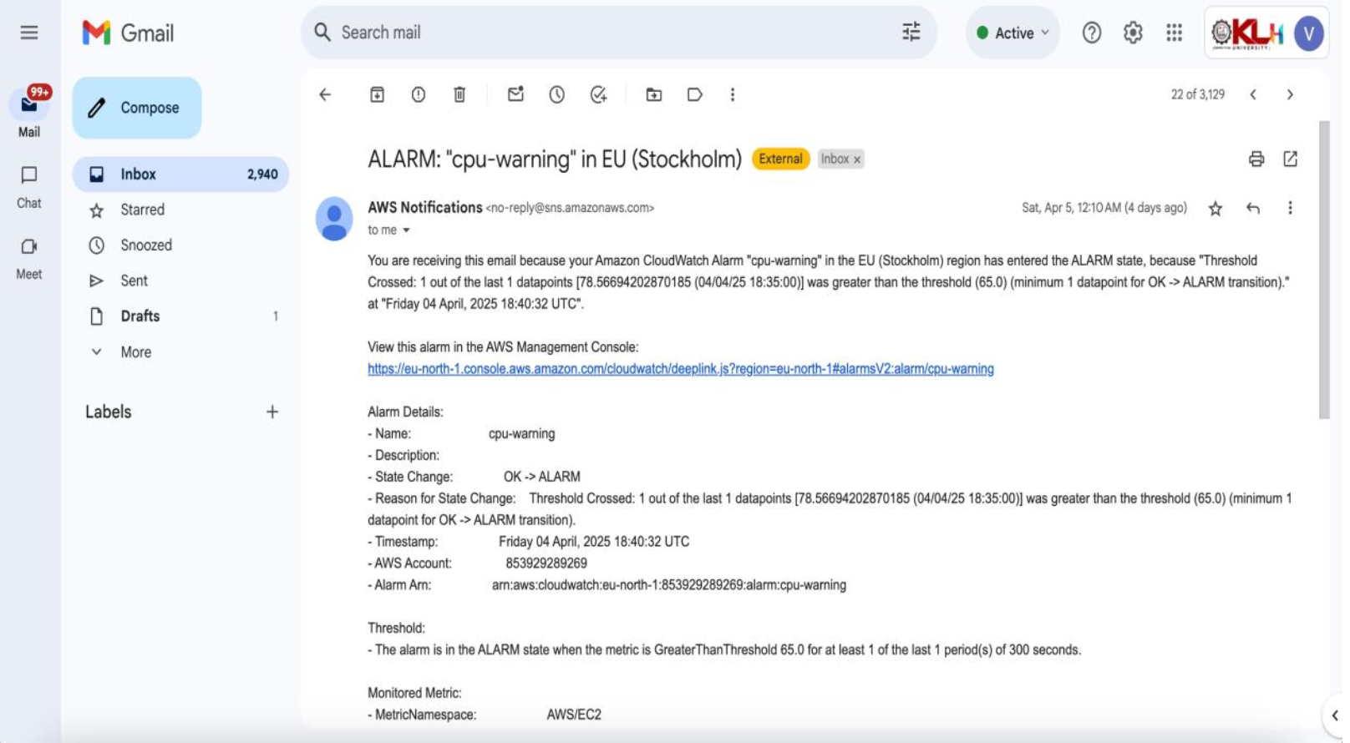

Slide 10
Challenges and Solutions
1. Accurate Alarm Threshold Configuration
Challenge: Initially, it was difficult to determine the right CPU utilization threshold for triggering CloudWatch alarms.
Solution: Simulated different workloads on the EC2 instance to observe CPU behavior, then fine-tuned thresholds accordingly.
2. Email Notification Delays
Challenge: Delay in receiving SNS email notifications after alarm trigger.
Solution: Verified SNS topic subscription and confirmation process. Ensured correct permissions and tested with alternate email accounts.

Slide 11
Learnings & Takeaways
• Understand the importance of monitoring application performance in
the cloud.
• Gain hands-on experience with AWS services such as EC2,
CloudWatch, and SNS.
• Learn how to set up alarms and notifications to proactively manage
application performance.
• Develop skills in using the AWS Management Console for resource
management.
• Enhance their ability to respond to real-time performance issues in
cloud environments.

Slide 12
Future Scope
The integration of Amazon SNS for notifications further enhances the
monitoring process, allowing administrators to receive instant alerts and take
timely actions. By mastering these monitoring techniques, businesses can
improve application reliability, optimize resource usage, and enhance overall
system performance. Furthermore, the project underscores the importance
of cloud-based observability tools in modern infrastructure management,
highlighting how real-time monitoring contributes to proactive decision-
making, operational efficiency, and cost savings in cloud computing
environments.

Slide 13
References
AWS CloudWatch Documentation: https://docs.aws.amazon.com/cloudwatch/
Amazon EC2 Documentation: https://docs.aws.amazon.com/ec2/
AWS Management Console: https://console.aws.amazon.com/
Hands-on practice on AWS Console
AWS Documentation – https://docs.aws.amazon.com

Slide 14
THANK YOU

